Slide 1

Note: The data and information in this document is reflective of a hypothetical situation and client. This document is to be used for KPMG Virtual Internship purposes only.
Sprocket Central Pty Ltd
Data analytics approach
[Division Name] - [Engagement Manager], [Senior Consultant], [Holly]

Slide 2
Note: The data and information in this document is reflective of a hypothetical situation and client. This document is to be used for KPMG Virtual Internship purposes only.
Agenda
Introduction
Data Exploration
Model Development
Interpretation
Notes:
It’s a plan.
Prepare a detailed approach for completing the analysis including activities – i.e. understanding the data distributions, feature engineering, data transformations, modelling, results interpretation and reporting. This detailed plan needs to be presented to the client to get a sign-off. Please advise what steps you would take.
Aim: find the high value customers
The marketing team at Sprocket Central Pty Ltd is sure that, if correctly analysed, the data would reveal useful customer insights which could help optimise resource allocation for targeted marketing. Hence, improve performance by focusing on high value customers.
Their marketing team is looking to boost business by analysing their existing customer dataset to determine customer trends and behaviour.
Using the existing 3 datasets (Customer demographic, customer address and transactions) as a labelled dataset, please recommend which of these 1000 new customers should be targeted to drive the most value for the organisation.
Time: 2h
Tips: Raw data fields may be transformed into other calculated fields for modelling purposes (i.e. converting D.O.B to age or age groups). Tips: You may source external data from the ABS / Census to add additional variables that may help support your model.

Slide 3
Note: The data and information in this document is reflective of a hypothetical situation and client. This document is to be used for KPMG Virtual Internship purposes only.
Introduction
Aim: Find the high value customers based on their attributes
We use the existing customers’ datasets to explore their trends and behaviours, then find the determines of the high value customers, and predict their values.
The existing datasets are: CustomerDemographic, CustomerAddress, Transactions, where CustomerDemographic and CustomerAddress include the customers’ features, and Transactions contains label data - standard cost with product information.
Notes:
What should I say in the Introduction Part?
understanding the data distributions, feature engineering, data transformations, modelling, results interpretation and reporting
train dataset: CustomerDemographic, CustomerAddress, Transactions
Main train(feature): CustomerDemographic & CustomerAddress
label: Transactions

Slide 4
Note: The data and information in this document is reflective of a hypothetical situation and client. This document is to be used for KPMG Virtual Internship purposes only.
Data Exploration
Datasets
CustomerDemographic
customer_Id: training dataset
CustomerAddress
combined with CustomerDemographic
state, postcode and property_valuation
Transactions
standard cost: the money that customers’ consumed - value
product information: customers’ trend and behaviour
Notes:
CustomerDemographic, CustomerAddress, Transactions

Slide 5
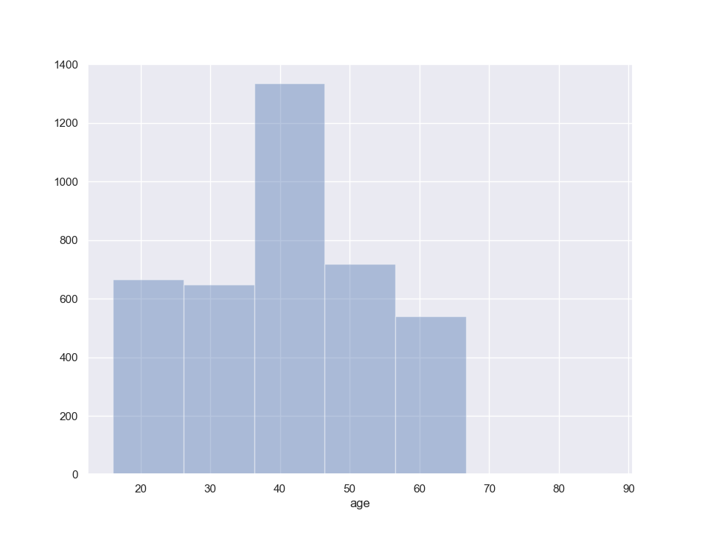
Note: The data and information in this document is reflective of a hypothetical situation and client. This document is to be used for KPMG Virtual Internship purposes only.
Data Exploration
CustomerDemographic
age
transformed from DOB: customers’ age when the year is 2018
range: 16 to 87
5 customers’ ages are bigger than 70
the median of age is 41
gender
U and NaN: impute through the distribution
job industry
Notes:
CustomerDemographic, CustomerAddress, Transactions

Slide 6
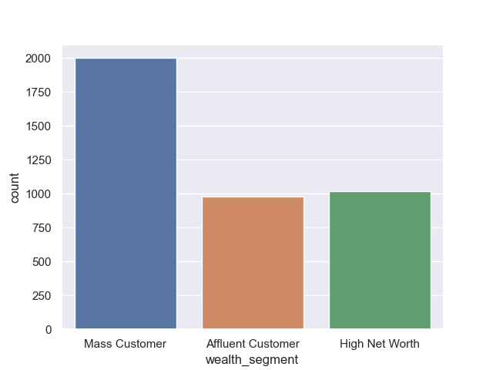
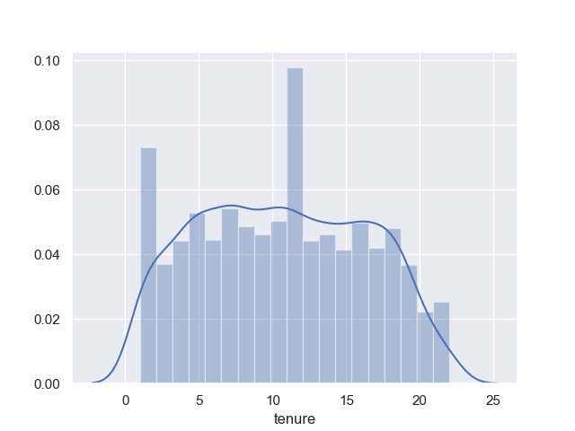
Note: The data and information in this document is reflective of a hypothetical situation and client. This document is to be used for KPMG Virtual Internship purposes only.
Data Exploration
CustomerDemographic
wealth segment
high net worth > affluent customer > mass customer
deceased indicator
owns_car
the numbers of customers with or without cars are similar (2024 vs 1976)
tenure
meaning:Tenure refers to the number of months that a customer has subscribed for.
median: 11
Notes:
CustomerDemographic, CustomerAddress, Transactions

Slide 7
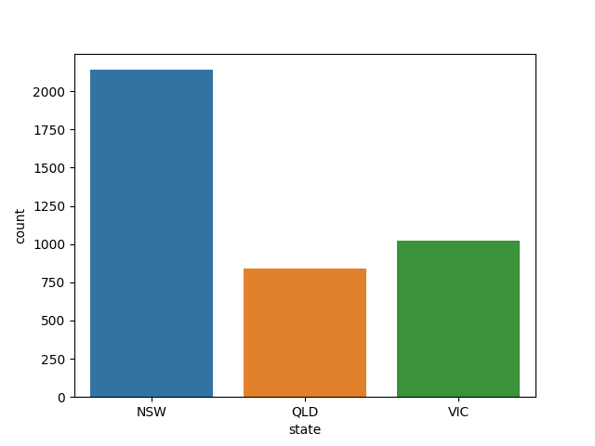
Note: The data and information in this document is reflective of a hypothetical situation and client. This document is to be used for KPMG Virtual Internship purposes only.
Data Exploration
CustomerAddress
postcode
transform postcode into the geography area
SA3 name
state
consistent expressions of the state abbreviations
NSW; VIC; QLD
property valuation
1 to 12
Notes:
CustomerDemographic, CustomerAddress, Transactions

Slide 8
Note: The data and information in this document is reflective of a hypothetical situation and client. This document is to be used for KPMG Virtual Internship purposes only.
Data Exploration
Transactions
count of transactions
approved vs cancelled
product attributes
the strategy for different customers
attributes
brand
product line
product class
product size
list price
standard cost
the value of customers
Notes:
CustomerDemographic, CustomerAddress, Transactions

Slide 9
Note: The data and information in this document is reflective of a hypothetical situation and client. This document is to be used for KPMG Virtual Internship purposes only.
Model Development
Multiple Linear Regression
Features
correlation to check the relationship between each variable and standard_cost
age, gender, job industry, wealth segment, tenure, state, postcode, property_valuation
label
standard_cost: mean(approved_standard_cost) - mean(cancelled_standard_cost)
Notes:
Which model? Why?
Multiple Linear Regression:
X: selected features
y: transform of standard costs

Slide 10
Note: The data and information in this document is reflective of a hypothetical situation and client. This document is to be used for KPMG Virtual Internship purposes only.
Interpretation

Slide 11
Note: The data and information in this document is reflective of a hypothetical situation and client. This document is to be used for KPMG Virtual Internship purposes only.
Appendix

Slide 12
Note: The data and information in this document is reflective of a hypothetical situation and client. This document is to be used for KPMG Virtual Internship purposes only.
Appendix
Australian postcode: http://www.matthewproctor.com/australian_postcodes
property valuation: https://www.realestate.com.au/advice/what-is-a-property-valuation/

